Slide 1
Data Structures and Algorithms in Python
Avoin AMK/Open UAS course
5 cu
Autumn/Syksy 2024
Chao GAO (D.Sc.)

Slide 2
Course Content
Python Basics
Python as OOP
Algorithm Analysis - what does "big-O" mean?
Dynamic Programming (Recursion)
Arrays, Stacks, Queues
Linked Lists and Trees
Maps and Hash Tables
Searching and Sorting
Graphs and Related Algorithms (STP, OSPF, etc.)
Machine Learning Algorithm -- Training a Neural Network

Slide 3
Chapter 0 Python Basics

Slide 4
What is and Why Python
Python is a high-level, general-purpose, object-oriented programming language. It emphasizes code readability with the use of significant indentation via the off-side rule. [Wikipedia]
Strictly formatted (indentation is compulsory)
Dynamically typed language (a variable can hold different types of data)
Garbage-collecting (collect all deleted objects)
Support structured, object-oriented, and functional programming paradigms
Reasons to use Python in this course:
Highly readable and portable
Built-in object-oriented data types (bool, int, float, list, tuple, str, set, frozenset, dict, etc.)
OOP paradigm
Interpreted language
Vast libraries
Indexing elements in list, tuple and set is convenient
Note: this is NOT a Python language course. Please study Python basics from online resources such as https://www.w3schools.com/python/.

Slide 5
Python Programming/Debugging Environment
Need a programming/debugging environment for Python.
The primitive way is Python Interpreter or Notepad++. But more convenient way is to use VS Code or Visual Studio.
This link (https://code.visualstudio.com/docs/python/python-tutorial) shows how to use VS Code with Python.
This link (https://learn.microsoft.com/en-us/visualstudio/python/?view=vs-2022) shows how to use Visual Studio with Python.
Visual Studio is recommended.

Slide 6
Data Structure 101: Use Correct Data Types
Be clear with the data to be handled.
E.g., if you want to hold all the prime factors of a number, you need to use a list; but if you want to hold all the distinct prime factors of a number, you need a set.
As a dynamically-typed language, Python can use the same variable to hold different type of data.
This feature has both advantages and disadvantages:
Pro: You can write code with more freedom and flexibility
Con: You may encounter a fatal error if you are not clear what the actual type of data is stored in a variable. (e.g., divided by a string)
A = 10.0 # assign a floating-point number
A = 'This is no joke' # assign a string
A = [None]*5 # making A as a list of 5 elements

Slide 7
Python Operators and Operator Precedence
There are 6 types of operators:
Logical operators: and, or, not
Equality operators: is, is not, ==, !=
Comparison operators: <, <=, >, >=
Arithmetic operators: +, -, *, /, //, %
Bitwise operators: ~, &, |, ^, <<, >>
Sequence/indexing operators: s[j], s[start:stop], s[start:stop:step]
Please refer to https://www.geeksforgeeks.org/precedence-and-associativity-of-operators-in-python/ for Operator Precedence.

Slide 8
List, Tuple, Set, Dictionary
4 Python data types able to a collection of data.
A List is mutable, ordered array.
You can use methods: append, clear, copy, count, extend, index, insert, pop, remove, reverse, and sort a list.
A Tuple is immutable, ordered array.
You can only change a tuple by converting it to a list and convert back.
You can only count, index a tuple.
A Set is an unordered, unsorted, immutable, and unindexed array.
Each element is unique in a set.
You can add, clear, copy, discard, pop, remove elements of a set.
You can get difference, intersection, union, isdisjoint, issubset, issuperset, update among multiple sets.
Dictionaries are used to store data values in key:value pairs. A dictionary is actually a map, unordered, mutable.
You can use methods: clear, copy, fromkeys, get, items, keys, pop, popitem, setdefault, update, values

Slide 9
Slicing and Indexing of List
Python offers Matlab-like indexing method for lists/tuples, making list indexing and slicing very convenient.
a = [1,2,3,4,5,6,7,8,9]
b = a[2] # b gets 3
c = a[1:4] # c gets [2,3,4]
d = a[-1] # d gets 9
e = a[2:7:2] # e gets [3,5,7]
f = a[4:] # f gets [5,6,7,8,9]
g = a[::2] # g gets [1,3,5,7,9]
h = a[::2][:2] # h gets [1,3]
k = a[::-1] # k gets [9,8,7,6,5,4,3,2,1]
m = a[3:1:-1] # m gets [4,3]
n = a[1:-3:2] # n gets [2,4,6]
1 | 2 | 3 | 4 | 5 | 6 | 7 | 8 | 9
Forward indexing:
0 | 1 | 2 | 3 | 4 | 5 | 6 | 7 | 8
-9 | -8 | -7 | -6 | -5 | -4 | -3 | -2 | -1
Backward indexing

Slide 10
Python Flow Control
Basics branching (conditional) control: if, elif, else
Loops (repetition): while, for
break and continue statements (for repetitions)
if condition1:
pass
elif condition2:
pass
elif condition3:
pass
else:
pass
while condition:
pass
for element in iterable:
pass

Slide 11
Python Functions
In most cases (especially in dynamic programming), we need to write detailed logics in functions so that we can handle a complex algorithm and its related data structure.
A Python function is defined by "def" keyword. As an example, the following function returns the standard deviation of a set of numbers:
import math
def stddev(data):
n = len(data)
mean = sum(data)/n
deviations = [(x - mean)**2 for x in data]
return math.sqrt(sum(deviations)/(n-1))
d = [1,2,3,4,5]
print("Std of %s is %.3f"%(d, stddev(d)))

Slide 12
Built-in Functions
Input/Output: print, input, open
Character encoding: ord, chr
Math: abs, divmod, pow, round, sum
Ordering: max, min, sorted
Collections/iterations: range, len, reversed, all, any, map, iter, next
Please refer to https://docs.python.org/3/library/functions.html

Slide 13
Python File Operations
Just like other languages, Python uses open(), close() to open/create and close a file.
A file can be opened in 'w/r/a/x/t/b' modes. E.g., fp=open('samples.dat','wb') will create a new file 'samples.dat' in binary write-only mode, if no such a file exists in the current folder; otherwise, it will open this file (and erase existing content) in write-only binary mode.
Functions used with an opened file could be:
Calling Syntax Description
fp.read(k) Return the next k bytes of a readable file as a string.
fp.readline( ) Return (remainder of ) the current line of a readable file as a string.
fp.readlines( ) Return all (remaining) lines of a readable file as a list of strings.
for line in fp: Iterate all (remaining) lines of a readable file.
fp.seek(k) Change the current position to be at the kth byte of the file.
fp.tell( ) Return the current position, measured as byte-offset from the start.
fp.write(string) Write given string at current position of the writable file.
fp.writelines(seq) Write each of the strings of the given sequence at the current
position of the writable file. This command does not insert
any newlines, beyond those that are embedded in the strings.
print(..., file=fp) Redirect output of print function to the file.

Slide 14

Python Examples: Finding all the primes below N
Two algorithms: Brute force and Eratosthenes sieve
Brute force:
Set prime_list = [ ]
For each integer i between 2 to N:
Let s = floor(sqrt(i))
If $s^{2}==i$: continue
Flag = TRUE
For k from 2 to s:
If s is divisible by k:
Flag = FALSE and break
If flag == TRUE
Add i to the prime_list
Print prime_list
import math
N = 100
prime_list = []
for k in range(2,N):
s = math.floor(math.sqrt(k))
if s*s == k: continue
flag = True
for i in range(2,s+1):
if k%i == 0:
flag = False
break
if flag == True:
prime_list.append(k)
print(prime_list)
print(len(prime_list))

Slide 15

Python Examples: Finding all the primes below N
Eratosthenes sieve:
Set eratos = [True]*(N+1)
Set d = 2
While $d^{2}≤N+1$:
If eratos[d] is True:
For every i in [$d^{2}, N+1$] , i+=d
Set eratos[i] = False
d = d+1
prime_list = []
for k in range(2, N+1):
If eratos[k]==True: prime_list.append(k)
Print(prime_list)
N = 100
eratos = [True]*(N+1)
d = 2
while d*d <= N+1:
if eratos[d] == True:
for i in range(d*d, N+1, d):
eratos[i] = False
d = d+1
prime_list = []
for i in range(2, N+1):
if eratos[i]:
prime_list.append(i)
print(prime_list)
print(len(prime_list))

Slide 16
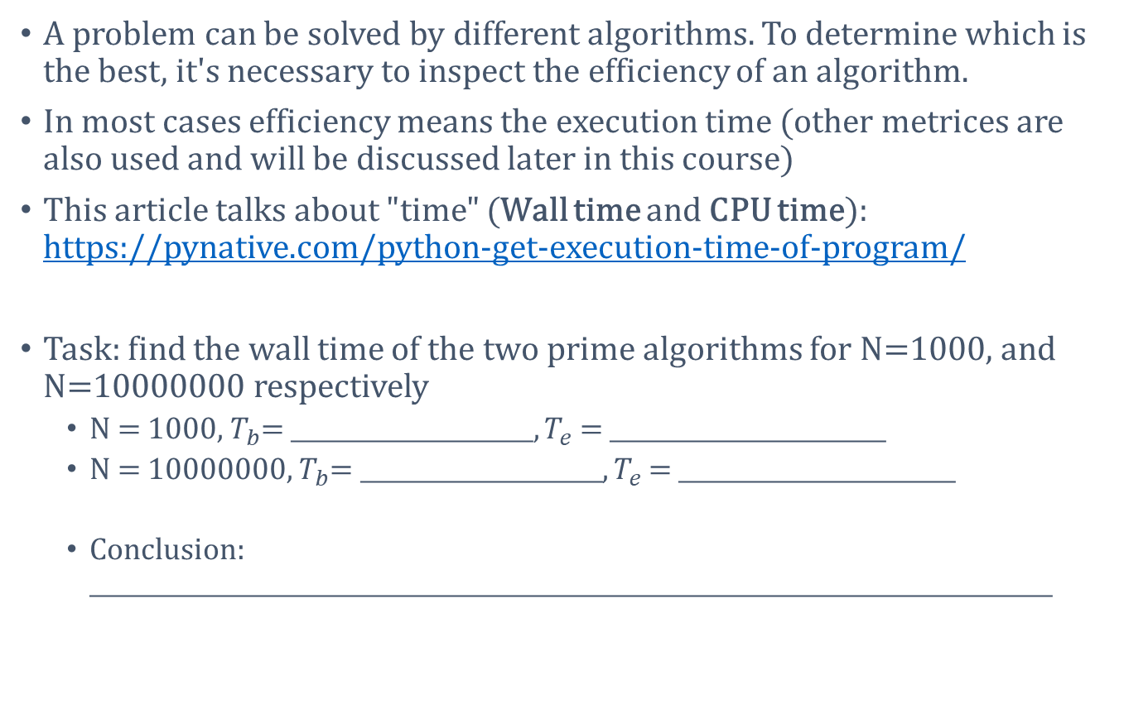
Algorithm Efficiency: Execution Time
A problem can be solved by different algorithms. To determine which is the best, it's necessary to inspect the efficiency of an algorithm.
In most cases efficiency means the execution time (other metrices are also used and will be discussed later in this course)
This article talks about "time" (Wall time and CPU time): https://pynative.com/python-get-execution-time-of-program/
Task: find the wall time of the two prime algorithms for N=1000, and N=10000000 respectively
N = 1000, $T_{b}$= _____________________, $T_{e}$ = ________________________
N = 10000000, $T_{b}$= _____________________, $T_{e}$ = ________________________
Conclusion: ____________________________________________________________________________________

Slide 17
Homework 1
Create an empty list, and add (append) numbers 1,3,5,…,19 to the list.
Create an empty set, and add strings "one", "two", "three", "four", "five" to it. If you then use pop() function, which one will be removed?
Write a Python function primeFactors(N), the function returns a list of all the prime factors of integer N. E.g., if N=24, it returns [2,2,2,3].
Write a Python function distinctPrimeFactors(N), the function returns a set of all the distinct prime factors of integer N. E.g., if N=24, it returns [2,3].
Write a Python program which read the txt file offered by the teacher. The txt file contains 1440 temperature samples in one day (1/minute). Please find out how many local maxima this curve has.

